Slide 1

License Plate Recognition System using Python and Opencv
Rajiv Gandhi University of Knowledge and Technology
Rk Valley
Submitted By
R170851 S Vivek
R170854 T Babji
R170856 U Govardhan
Project Guide
Mr. P Santhosh Kumar

Slide 2
Contents :
Introduction
Technologies Used
Module’s Information
Data Flow Diagram
Test Cases
Demonstration and Screenshots
Future Enhancements
Sources

Slide 3
Introduction :
License Plate Recognition(LPR) is a type of technology, mainly software that enables computer systems to read automatically the registration number (license number) of vehicles from digital pictures.
License Plate Recognition Systems use the concept of optical character recognition to read the characters on a vehicle license plate.In other words, LPR takes the image of a vehicle as the input and outputs the characters written on its license plate

Slide 4
Steps :
This License Plate Recognition System takes three major steps to get license plate number :
License Plate Recognition
Character Segmentation
Character Recognition

Slide 5
Cont. :
License Plate Recognition :
This is the first and probably the most important stage of the system .It is at this stage that the position of the license plate is determined.The input at this stage is an image of the vehicle and the output is license plate.
Character Segmentation :
It’s at this stage the characters on the license plate are mapped out and segmented into individual images.
Character Recognition :
This is where we wrap things up . The characters earlier segmented are identified here . We have used machine learning for this.

Slide 6
Technologies Used
Operating Systems :
Window 10
-Window 10 is a Microsoft System for personal computers.
Ubuntu 20.04
-Ubuntu is free and open source operating system and Linux distribution based on the Debian.
Programming Language :
Python
-Python is a high-level, general-purpose programming language .Its design philosophy emphasizes code readability with use of significant indentation.

Slide 7
Module’s Information
OpenCV
- Opencv is library of python programming functions mainly aimed at
real-time computer vision.
Numpy
-Numpy is used for general purpose array processing package. It
provides a high-performance mainly multi-dimensional array object
and tool for working with these arrays .
Pytesseract
- Python-tesseract is an optical character recognition (OCR) tool for
python . It will recognize and read the text embedded in the
images.

Slide 8
Cont.
EasyOCR :
-It is a python module for extracting text from image . It is general OCR that can read both natural scene text and dense text in document.
Matplotlib :
-It is a plotting library for python and ite numerical mathematics
extension Numpy.It provides an Object-Oriented API for embedding
plots into applications using general purpose GUI.
iMUTILS :
-A series of the convenience functions to make basic image processing functions such as translation, rotation, resizing etc.
Tkinter :
-It is standard python interface to the Tk Graphical User Interface.

Slide 9
Data Flow Diagram :
.
Start
License Plate Detection
Input Image
Character Segmentation
Compile
Character Recognition
Image Processing
License plate number is printed

Slide 10
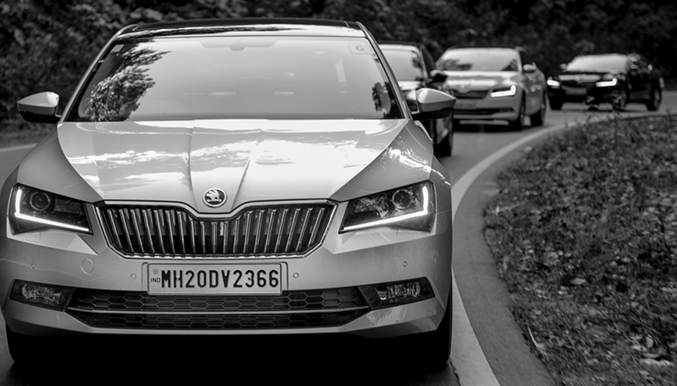
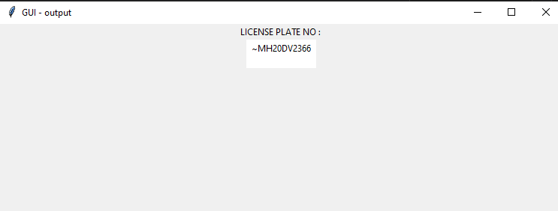
Test Cases
Input Image Output

Slide 11
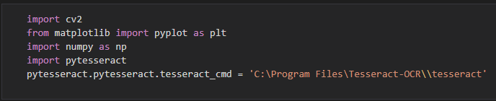
Demonstration and Screenshots :
Importing Modules :
Before applying machine learning , we need to import required modules in python file to implement the Licence Plate Recognition System.

Slide 12
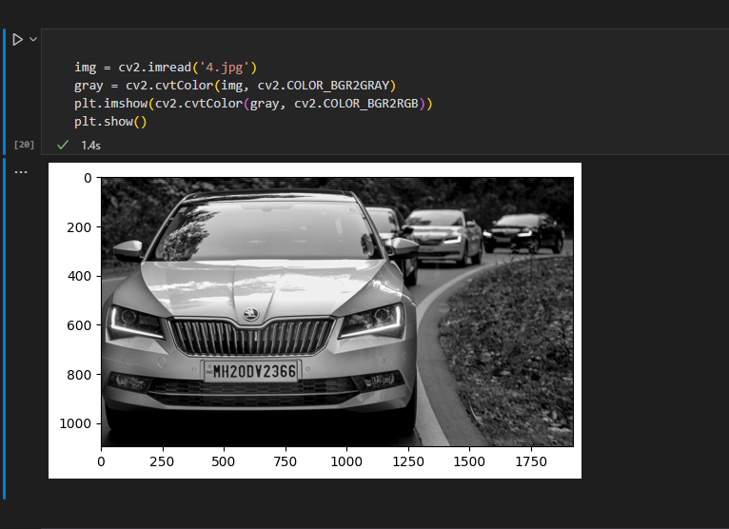
Demonstration and Screenshots :
Reading Image and Converting it into Gray scale Image :
By using openCV , we can read image from user with the help of cv2.imread(‘path’) method.After reading image, we need to apply gray scale on input image which simplifies the algorithms and reduces a computational requirements of machine learning.

Slide 13
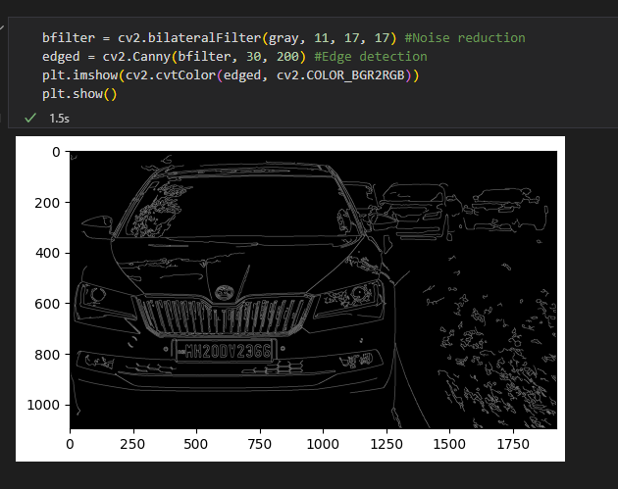
Demonstration and Screenshots :
Applying BilateralFilter and Canny Edge Detection :
Applying BilateralFilter on gray scale image to reduce the noise in it. This process will make gray scale image so smoothen which will help to find required edges on image by using Canny Edge Detection method.

Slide 14
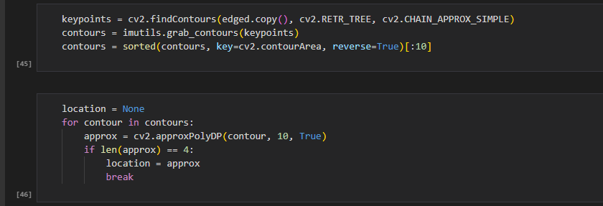
Demonstration and Screenshots :
Finding the Contours from edged image :
The contours are a useful tool for shape analysis and object detection and recognition. We need to find contours for rectangular shape in edged image to detect the license plate in input image.

Slide 15
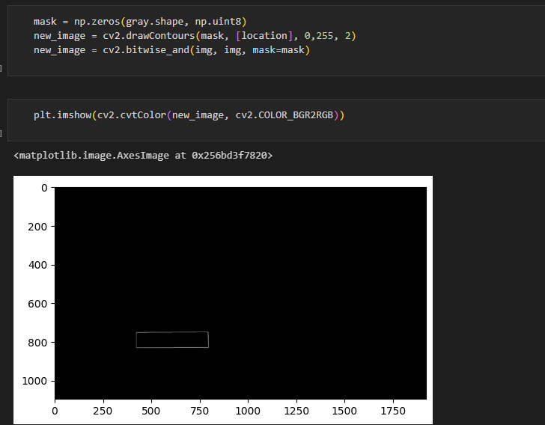
Demonstration and Screenshots :
Rectangle shape detection :

Slide 16
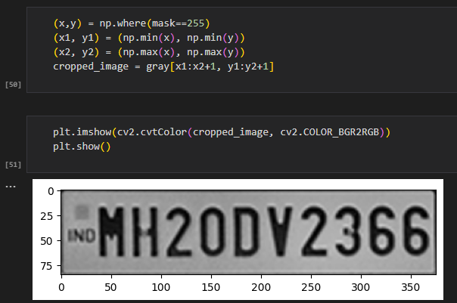
Demonstration and Screenshots :
Cropped image of license plate :
Once rectangular shape is detected ,we need to crop license plate with the help of the rectangular shape contours to apply OCR tool.

Slide 17
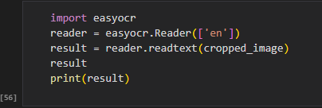
Demonstration and Screenshots :
Extracting characters from cropped image :
Here we apply EasyOCR to recognize and read the characters from cropped image . These identified characters are the characters of license plate of input image, simply called as license plate number

Slide 18
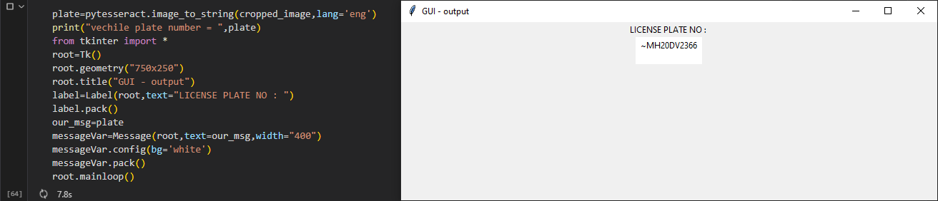
Demonstration and Screenshots :
GUI for display license plate number using Tkinter :

Slide 19
Future Enhancements :
The project currently works with given input image only and can be modified in future to be implemented to extract license plate automatically
Efficiency of the project can be increased by improving the characters segmentation algorithm so it can be applicable to various types of car’s images
Image processing speed can be increased by installing faster processors
More number of characters datasets can be trained with the project, so we can detect and recognize the characters of different types of fonts which can be used in license plate

Slide 20
Sources :
https://en.wikipedia.org/wiki/Digital_image_processing
https://www.researchgate.net/publication/299858935_Proposal_for_Automatic_License_and_Number_Plate_Recognition_System_for_Vehicle_Identification
https://en.wikipedia.org/wiki/Automatic_number-plate_recognition
https://docs.opencv.org/4.x/d9/df8/tutorial_root.html
https://numpy.org/learn
https://www.python.org/about/gettingstarted/
https://pypi.org/project/pytesseract/

Slide 21

THANK YOU

